Slide 1
The Opioid Epidemic:
It’s a Crisis

Slide 2
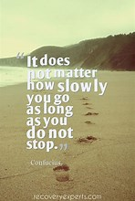

Slide 3
The Crisis Next Door
When President Trump took office the opioid crisis was devastating communities.
Nearly 64,000 Americans died from a drug overdose in 2016 alone.
Opioid overdoses accounted for more than 42,000 of these deaths, more than any previous year on record.
In October 2017, President Trump declared the opioid crisis a public health emergency.
https://www.crisisnextdoor.gov/

Slide 4
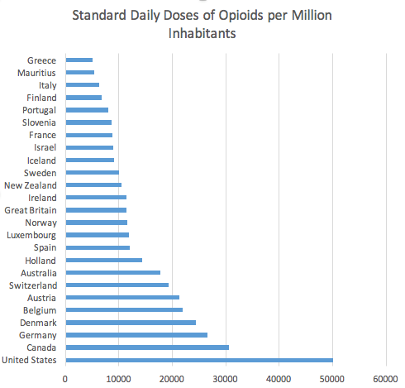
The U.S. has 5% of the world population and consumes 80% of the opioid supply
Source: United Nations International Narcotics Control Board

Slide 5
Ted Talk: Travis Reider - A Personal Story
https://www.youtube.com/watch?v=WhpAYw9kCt8

Slide 6
HHS.GOV – THE OPIOID EPIDEMIC BY THE NUMBERS
In the United States in 2018:
47,600 people died from overdosing on opioids
2.0 million people had an opioid use disorder
81,000 people used heroin for the first time
808,000 people used heroin
Updated October 2019. For more information, visit: http://www.hhs.gov/opioids/

Slide 7
April 2018 NIH launches the H.E.A.L. initiative –Helping to end addiction long-term
The NIH HEAL InitiativeSM is an aggressive, trans-agency effort to speed scientific solutions to stem the national opioid public health crisis.
Almost every NIH Institute and Center is accelerating research to address this public health emergency from all angles.
The $945 million initiative is funding hundreds of projects nationwide.
Researchers are taking a variety of approaches to tackle the opioid epidemic through:
Understanding, managing, and treating pain
Improving treatment for opioid misuse and addiction

Slide 8
September 2019 Trump Administration Provides $1.8 Billion in Funding to States
The U.S. Department of Health and Human Services (HHS) announced more than $1.8 billion in funding to states to continue efforts to combat the opioid crisis by expanding access to treatment and supporting near real-time data on the drug overdose crisis.
The Centers for Disease Control and Prevention announced more than $900 million in new funding for a three-year cooperative agreement with states, territories, and localities to advance the understanding of the opioid overdose epidemic and to scale-up prevention and response activities, releasing $301 million for the first year.
The Substance Abuse and Mental Health Services Administration awarded approximately $932 million to all 50 states as part of its State Opioid Response grants.
By the end of 2019, HHS will have awarded more than $9 billion in grants to states and local communities to help increase access to treatment and prevention services since the start of the Trump administration.

Slide 9
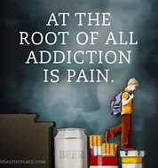

Slide 10
D.A.O.D.A.S. - In Horry County South Carolina 2017
Overdose Total *Rate Opioids *Rate
South Carolina 1,001 20.4 748 15.5
Charleston 118 27.6 94 22.1
Georgetown 18 36.2 14 27.8
Greenville 107 21.1 73 14.7
Horry 103 35.2 77 27.0
Lancaster 24 28.7 23 27.6
Richland 93 23.1 71 17.9
*Rate is per 100,000 people

Slide 11
D.A.O.D.A.S. - In Horry County South Carolina 2018
Overdose Total *Rate Opioids *Rate
South Carolina 1,103 22.2 816 16.7
Charleston 121 29.0 100 24.2
Georgetown 23 43.9 16 28.9
Greenville 172 33.7 131 26.4
Horry 105 35.1 85 29.1
Lancaster 14 17.0 12 15.4
Richland 85 20.5 51 12.3
*Rate is per 100,000 people

Slide 12
Sun News- February 16, 2020

Slide 13
July 2019 WMBF –South Carolina ranks as one of the top states for opioid distribution
https://www.wmbfnews.com/2019/07/19/south-carolina-ranks-one-top-states-opioid-distribution/

Slide 14
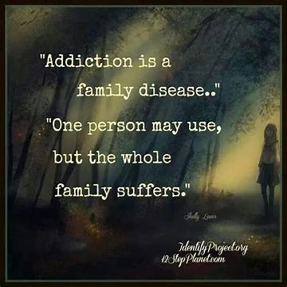

Slide 15
A Mother’s Story
https://www.youtube.com/watch?v=vScH_2loKJM
Andrew

Slide 16
N.I.D.A. - Addiction is a Disease of the Brain
Addiction is defined as:
A chronic, relapsing disorder characterized by compulsive drug seeking and use despite adverse consequences.
A brain disorder, involving functional changes to brain circuits related to reward, stress, and self-control; changes that may last a long time or be permanent.
Addiction is much like other diseases, such as heart disease or diabetes.
Both-
Disrupt the normal, healthy functioning of an organ in the body.
Have serious harmful, life-threatening effects.
Are mostly preventable and treatable.
If left untreated, have a high probability of resulting in death.

Slide 17
The Disease of Addiction
https://www.youtube.com/watch?v=uSvX33Z_iuQ
https://www.youtube.com/watch?v=LNk8J5AFsFg

Slide 18
DSM 5 Definition of Substance Use Disorder
The DSM-5 states that in order for a person to be diagnosed with a disorder due to a substance, they must display 2 of the following 11 symptoms within 12-months:
Consuming more alcohol or other substance than originally planned
Worrying about stopping or consistently failed efforts to control one’s use
Spending a large amount of time using drugs/alcohol, or doing whatever is needed to obtain them
Use of the substance results in failure to “fulfill major role obligations” such as at home, work, or school.
“Craving” the substance (alcohol or drug)
Continuing the use of a substance despite health problems caused or worsened by it. This can be in the domain of mental health (psychological problems may include depressed mood, sleep disturbance, anxiety, or “blackouts”) or physical health.

Slide 19
DSM 5 Definition of Substance Use Disorder
Continuing the use of a substance despite its having negative effects on relationships with others (for example, using even though it leads to fights or despite people’s objecting to it).
Repeated use of the substance in a dangerous situation (for example, when having to operate heavy machinery or when driving a car)
Giving up or reducing activities in a person’s life because of the drug/alcohol use
Building up a tolerance to the alcohol or drug. Tolerance is defined by the DSM-5 as “either needing to use noticeably larger amounts over time to get the desired effect or noticing less of an effect over time after repeated use of the same amount.”
Experiencing withdrawal symptoms after stopping use. Withdrawal symptoms typically include, according to the DSM-5: “anxiety, irritability, fatigue, nausea/vomiting, hand tremor or seizure in the case of alcohol.”

Slide 20
N.I.D.A.- Components of effective treatment
Drug addiction can be treated, but it’s not simple.
Addiction is a chronic disease, people can’t simply stop using drugs for a few days and be cured.
Most patients need long-term and/or repeated care to stop using completely and recover their lives.
Addiction is a complex but treatable disease that affects brain function and behavior; no single treatment is right for everyone.
Based on scientific research since the mid-1970s, the following key principles should form the basis of any effective treatment program:

Slide 21
N.I.D.A.- Components of effective treatment
Addiction treatment must help the person do the following:
Stop using drugs
Stay drug-free
Become productive in the family, at work, and in society
The recovering person must have:
Quick access to affordable treatment.
All of their mental health needs addressed, not just his or her drug use.
Be able to stay in treatment as long as needed.

Slide 22
N.I.D.A.- Components of effective treatment
Counseling and other behavioral therapies are the most commonly used forms of treatment.
Medications are often an important part of treatment, especially when combined with behavioral therapies.
Treatment plans must be reviewed often and modified to fit the patient’s changing needs.
Medically assisted detoxification is only the first stage of treatment.
Long-term follow-up is essential to prevent or manage relapse
Treatment doesn't need to be voluntary to be effective.
Drug use during treatment must be monitored continuously.

Slide 23
A clinician’s perspective of recovery Counselor Carl
https://www.youtube.com/watch?v=2xOLPQZ5rYg

Slide 24
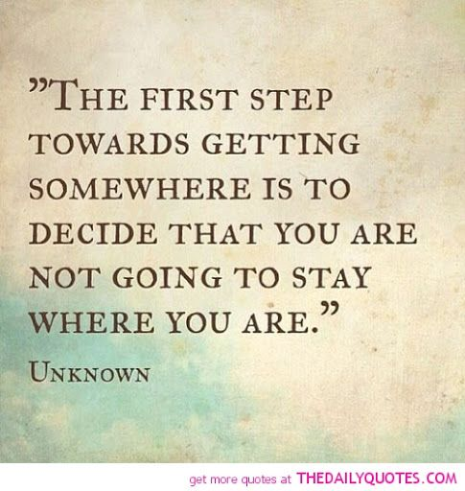

Slide 25
2018 Opioid Study Renee Causey
https://wpde.com/news/local/what-a-researcher-says-could-slow-the-opioid-epidemic-in-the-grand-strand-area

Slide 26
Horry/Georgetown 2018 Opioid Study Overview Pgs. 34-37
Major Key Points of this study show we need:
More funding; we are not getting our share of state funds (2% of $24 million)
Coordination of services; services are often fragmented, ineffective, and wasteful
Long-term residential (at least 60 days), evidence-based, peer supported treatment
Other Key Points:
Support for and oversight of Half-Way/Recovery houses
More public education and an educational curriculum in the schools
Best Practices education for treatment providers
Detox services that are accessible and affordable
Expansion of Naloxone access to family members, other providers
Expansion of peer support program
Access to transportation for treatment

Slide 27
The Center for Counseling & Wellness- A proposal for Horry County
We are RISING UP–
R.I.S.E. Recognize Intervene Support Enlighten
Become an-
U.P. Unstoppable Proponent
The Center for Counseling & Wellness is taking a stand for change
We are a 501c3 agency established in 2011 to serve the all of the community with out-patient mental health and addiction services regardless of ability to pay for services

Slide 28
The Center for Counseling & Wellness- A proposal for recovery in Horry County
We propose a local, residential Intensive Out-Patient (IOP) treatment program that will:
last as long as the recovering person needs it
be affordable – potentially cost no more than $20-$100 per day
be structured in small 10-12 person groups with significant professional and peer support
provide licensed professional individual, family, and group counseling
use well-developed, evidence-based treatments to address substance abuse and mental health issues, education, job readiness, and development of healthy social support

Slide 29
The Center for Counseling & Wellness- A proposal for recovery in Horry County
provide case management: transportation to meetings and appointments, access to medical care including MAT, help finding jobs and safe housing, and further education
have professional supervision/oversight to ensure the integrity of the program
be gender specific
focus on getting the recovering person back to being a functional member of society again
be sustainable and be replicated as often as needed
be available to all those who need and want it

Slide 30
Women’s Recovery Center, Xenia, OH A real life example of treatment
https://www.recoverycentersinc.org/about-us/our-organization-2/

Slide 31
The Center for Counseling & Wellness- A proposal for recovery in Horry County
We propose establishing “RISE UP Recovery Groups” throughout Horry County to provide recovery services for up to 12 people in each group that is affordable, effective, and accessible.
The Horry and Georgetown Counties Opioid Study, 2018 mentions three places that are available for expansion of services.
J. Reuben Long (pg 28)
New Directions (pg 30)
Sea Haven (pg 30)
The Center already has established relationships with these local agencies where we could these provide services with licensed mental health and addiction counselors, case managers, and supervisors. We currently provide on-site services for New Directions.

Slide 32
N.I.D.A.- On Incarcertion
The substantial prison population in the United States is strongly connected to drug-related offenses. While the exact rates of inmates with substance use disorders (SUDs) is difficult to measure, some research shows that an estimated 65% percent of the United States prison population has an active SUD. Another 20% percent did not meet the official criteria for an SUD, but were under the influence of drugs or alcohol at the time of their crime

Slide 33
How can we make this happen? The Cost of Treatment:
The potential cost of a person attending a RISE UP recovery group would be
$20 per day; $1800 per 90 days; $ 7300 per year
Compare this to:
Avg. 2016 Pharmaceutical rep. salary $64,037
2020, Glassdoor, Inc
One year at Harvard $47,000
Heart bypass surgery $40,000
30 days at Bluff Plantation, GA $35,000
2018 Recovery Advisor Psychology Today
One-year incarceration in US $31,000
One-year incarceration in SC $23,674
South Carolina Department of Corrections 9/9/2019

Slide 34
So who will pay?
County, State, Federal Funds
Insurance companies
Hospitals
Businesses
Grant funders
Churches
Individuals
Pharmaceutical companies

Slide 35
Get involved
Give your time – join in the movement
Give your talents – do what your good at, help with social media, get trained to learn new things
Give your resources – provide finances, donate transportation (or be a driver), cook and serve meals, connect with other agencies, help with fundraisers
Give your prayers - never stop praying, involve others in prayer, spread the word

Slide 36
Attend the Governor’s SC Opioid Summit March 24-25 in Columbia
Bringing together state agencies, private partners, law enforcement, healthcare providers, first responders, and community members to combat the growing epidemic of opioid abuse, addiction, and deaths.
This is the third year people will meet to discuss new approaches to this ongoing crisis, and to reaffirm commitment to the health and well-being of all South Carolinians.
Sponsored by DAODAS at the Columbia Metropolitan Convention Center
Plan to go next year

Slide 37
Specifically at the local level- Next Steps:
Join our website email list, stay informed: thecenter4counseling.com
Spread the word
Reach out to local government officials, provide information, send letters, make noise, solicit support
Attend R.I.S.E. events and other informational workshops: access workshops and events on The Center’s website
Connect, connect, connect on a regular basis: go for coffee; invite others to tour your agency/church; ask to tour other’s agencies, attend city council meetings
Call or text Roberta at 937-671-7703 or email roberta4thecenter@gmail.com

Slide 38
Go beyond talking about it – Do it! R.I.S.E. U.P.
Put Horry County at the bottom of the list of overdose deaths!
RISE UP:
Recognize the need
Intervene assertively
Support passionately
Enlighten others –
Become an
Unstoppable
Proponent for change

Slide 40
List of Resources: County
The Center for Counseling & Wellness – Roberta Bogle, Clinical Director; Ron Bogle, Executive Director
Free Ministry Recovery Farm – Jim Boudreau, Founder
Horry County Coroner – Robert Edge
J. Reuben Long – Chaplain Eddie Hill, Marcus Rhoades
Georgetown County Alcohol and Drug Commission – Raphael Smoak
Georgetown Sheriff’s Office – Major Staub
Greater Love Homes – Shelly Waldroup Gerald, Executive Director and Founder
Horry/Georgetown FAVOR – Faces and Voices of Recovery – Dr. Archambeau, Chair
Horry County Police Department – Chief Hill
Horry County Sherriff’s Department
Horry/Georgetown County Drug Court – Candy Strickland

Slide 41
List of Resources: County (continued)
New Directions Housing Shelter – William Howsare, Peer Support; Kathy Jenkins, Executive Director
Oxford Houses – Jason Brand, Regional Director
Recovery Ranch – Christa and Rich Reynolds, Founders
Refuge of Hope Recovery House – Dr. Archambeau, Chair
RISE – Recognize, Intervene, Support, Enlighten – Illyana and Justin Annunziato
Sea Haven for Youth – Christina Jackson, Executive Director
Shoreline Behavioral Health – Charles Bell, Deputy Director
Tidelands Health – Dr. Victor Archambeau
Voices of Recovery – Denis and Noreen Beck, Founders
15th Circuit Solicitor’s Office – J. Richardson

Slide 42
List of Resources: State, Federal
STATE
DAODAS –Department of Alcohol and Other Drug Abuse Services
FEDERAL
ACA – Affordable Care Act
CDC – Center for Disease Control
HHS – Health and Human Services
HRSA – Health Resources and Services Administration (helps underserved areas)
NIDA – National Institute on Drug Abuse
NIH – National Institute of Health
Parity Act – gives mental health and substance abuse treatment parity with medical care
SAMHSA – Substance Abuse and Mental Health Services Administration

Slide 43
Appendix: Terms
Buprenorphine - is an opioid partial agonist; it produces effects such as euphoria or respiratory depression at low to moderate doses; however, these effects are weaker than full opioid agonists such as heroin and methadone
Bunavail - buprenorphine and naloxone; buccal film
MAT – Medication Assisted Treatment
Methadone - a medication used to treat Opioid Use Disorder (OUD); full opioid agonist, schedule II controlled medication.
Naloxone – an opioid antagonist medication that is used to reverse an opioid overdose.
Naltrexone – binds and blocks opioid receptors; is reported to reduce opioid cravings; no abuse and diversion potential
Narcan – Brand name for Naloxone
Suboxone – Buprenorphine and Naloxone film
Subutex – Buprenorphine sublingual tablets
Vivitrol – extended release form of Naltrexone
Zubsolv – Buprenorphine and Naloxone sublingual tablets

